Slide 1
Integrate immigrant youth in 2019: what do you mean?
An example of an integration and awareness project "by, for and with" young Francophones in Saskatchewan

Slide 2

Who should get involved?
Young newcomers
Associations and groups dedicated to youth, with young staff, interested in youth issues
Partners with young staff, interested in youth
Young public leaders, interested in youth

Slide 3

What do they have in common?
UNDERSTANDING
SKILLS
INTEREST
CAPACITY
TO DO "BY, FOR AND WITH" YOUTH

Slide 4
To do what?
Double challenges
(1) mobilization and engagement of "young" stakeholders
(2) integration and inclusion of youth newcomers in host communities

Slide 5

To answer what issues?
Inclusion of young newcomers
Inclusive leadership development
Building Welcoming and Inclusive Communities

Slide 6

Project example - Ce que j’apporte ICI
https://www.rif-sk.ca/engagement/ressources#capsules-video-ce-que-j-apporte-ici

Slide 7
Stakeholders involvement
Young newcomers
Associations and groups dedicated to youth, with young staff, interested in youth issues
Partners with young staff, interested in youth
Young public leaders, interested in youth

Slide 8




In a win-win situation
Networking
Role model for peers
Honor culture of origin
Position as a leader in the host community
Keep alive the memory of young people
Promote the notion of heritage to younger audience
Expand the audience of the organization
Position as a leader in the host community
Fulfill its mandate of community player
Reach out to a desirable audience
Position as a leader in the host community
Put forward Francophone immigration
Celebrate diversity
Encourage networking opportunities
Position as a leader in the host community

Slide 9

What does it look like?

Slide 10
What for, concretely?
Learn to speak in front of a camera
Add a link on a resume
Feed an online profile
Educate and raise awareness of the host culture
Save past and present memory of Saskatchewan’s people
Offer an educational resource to Saskatchewan's Francophone Education Circle
Feed a web platform with content "by, for and with" the community
Promote community partnerships
Provide Network with community engagement tools
Capitalize on partnerships to realize projects with (very) low budget

Slide 11
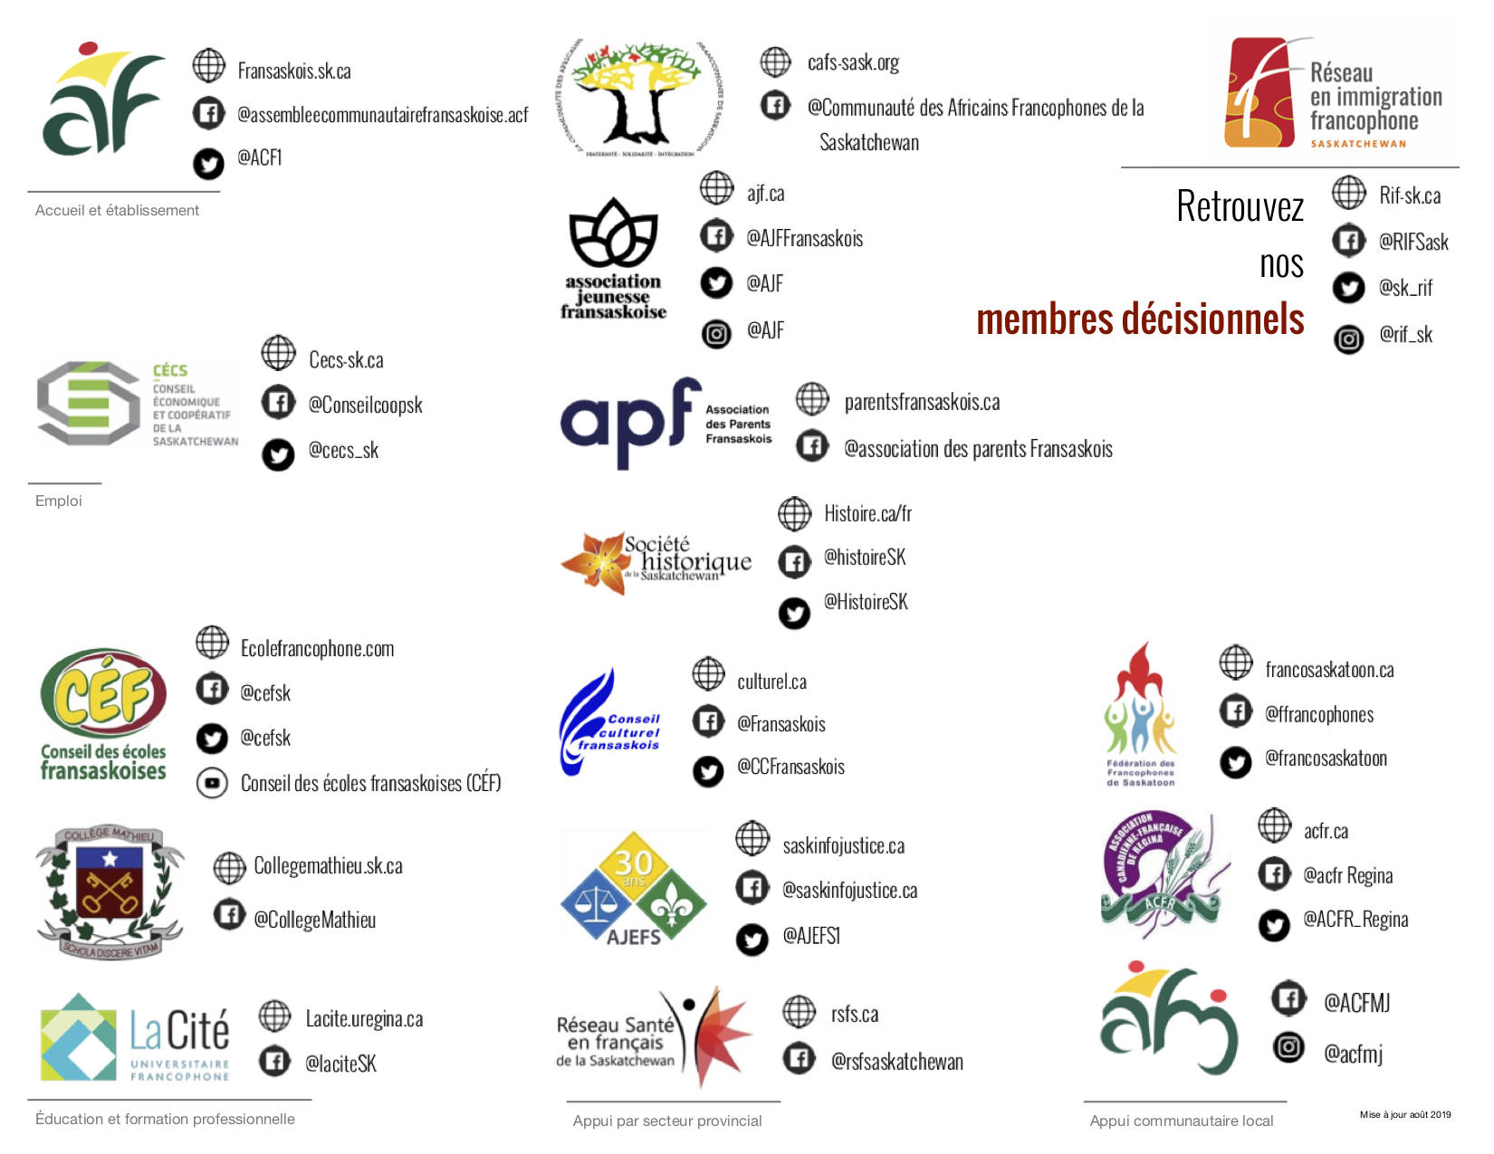
Next steps
Restructuring the project to include more stakeholders – The proof is in the pudding.

Slide 12

Next steps
Campaign launch of the second edition: National Francophone Immigration Week 2019 (FCFA)
November 2019
Distribution of 3 new videos: Mois de la francophonie
Mars 2020

Slide 13


